Slide 1
Light Waves
Chapter 1 Guiding Question: How does light from the sun cause skin cancer?

Slide 2
Pre-Test
Directions:
Log-in to Chromebook
Click on Amplify link in Google Classroom.
Log in with Clever- it will make you create and accout
Find Lesson 1:1 Light Waves Pre-Assessment
Notes:
Day 1

Slide 3
Lesson 1.2
Warm-up:
The sun causes changes to things on Earth. Think of an object you have observed before and after it was left out in the sun. Describe how it changed.
Notes:
Day 2 Warm-up, can use question as a bellringer instead

Slide 4
Lesson 1.2
Unit Question: How does light interact with materials.
When light hits materials, different things happen. Something left in the sun can become warm or even change color. How does light from the sun cause materials to change? Light must be interacting with the materials to cause these changes. This is what we will be investigating in this unit.
Notes:
Day 2

Slide 5
Lesson 1.2 Spectroscopist
Dr. Whitmore is a spectroscopist, a scientist that studies light and how it interacts with materials. In this unit, you will take the role of a student spectroscopist.
Notes:
Day 2, discuss video as a class

Slide 6
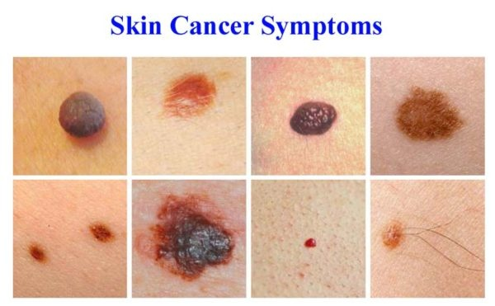
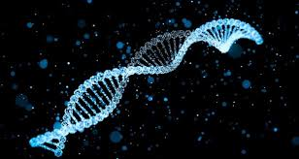
Lesson 1.2 Investigation of Skin Cancer
As student spectroscopists, you will investigate a specific change caused by the sun; skin cancer.
Light from the sun can damage genetic material inside skin cells, and, over time, exposure to light from the sun may lead to skin cancer. Cancer is caused when genetic material, or DNA, in cells is damaged.
Notes:
Day 2

Slide 7
Answer the Questions using the map below.
Notes:
Day 2, ask students “What do the colors on this map indicate?” Discuss range/key too

Slide 8
Answer the following Questions.
Which places have the lowest rates of skin cancer?
Which places have the highest rates of skin cancer?
What ideas do you have about WHY different places have lower or higher rates of skin cancer?
Notes:
Day 2

Slide 9
Notes:
Day 2

Slide 10
Lesson 1.2 Key Concept and Flashlight Activity
Write the following key concept at the bottom of your paper:
The movement of energy can be tracked by observing the changes the energy causes to matter.
Can you think of any examples?
Complete the Flashlight Activity, address the following:
What changes did you observe?
How do you know that energy caused these changes?
How did the energy get to the objects?
Notes:
Day 2 :
What changes did you observe? paper changed color, flowers danced, etc
How do you know that energy caused these changes? energy is present anytime something moves or changes
How did the energy get to the objects? light must have carried the energy

Slide 11
Learning log
What is one piece of evidence you collected that proves that light carries energy?

